Slide 1






KONGU ENGINEERING COLLEGE
PERUNDURAI ERODE-638060
DEPARTMENT NAME
KEC IDEATHON
TITLE OF THE PROJECT
Team Lead: Name (Roll No.)
Team Members: Member 1 ( Roll No.)
Member 2 ( Roll No.)
Member 3 ( Roll No.)
Member 4 ( Roll No.)
Member 5 ( Roll No.)
Technology Readiness Level: TRL --
Team Mentor with Designation and Department:
In association with:

Slide 2


The Problem
Define the problem and its relevance to today's market / society / industry need – specify the Pain Points of the intended user ( your target customer)
Use Images / Photos / Video | Don’t just answer given points in slides | Avoid para | Use bullet points

Slide 3
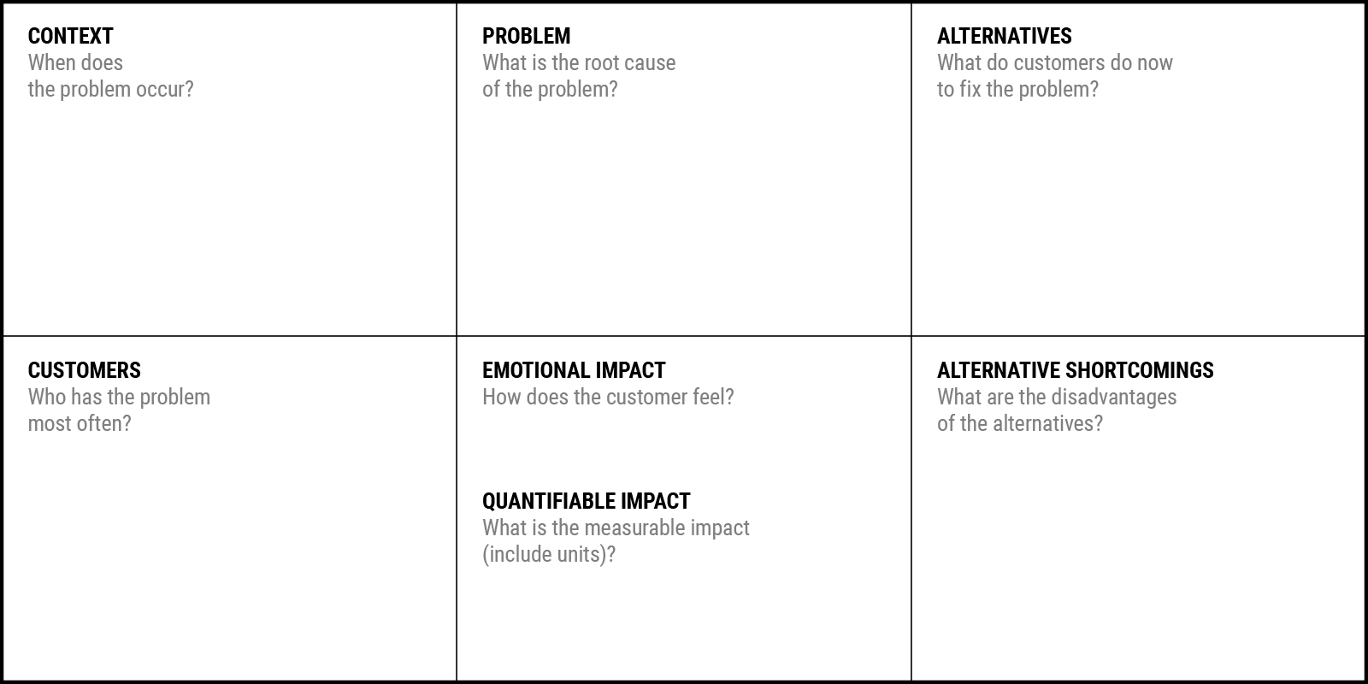
Problem statement
Problem Statement Canvas
Your Answer:
Your Answer:
Your Answer:
Your Answer:
Your Answer:
Your Answer:
Your Answer:

Slide 4
The Solution
Identified solution to the specific pain points (problem)
Whether the solution is a new one or improved from existing one?
Problem- solution fitness to be addressed
Unfair advantage content – something that cannot be easily copied?
Use Images / Photos / Video | Don’t just answer given points in slides | Avoid para | Use bullet points

Slide 5
Flowchart / Product workflow
Your flowchart should explain “How to implement your solution to solve the identified pain points/ problem”
Use Images / Photos / Video | Don’t just answer given points in slides | Avoid para | Use bullet points

Slide 6
Existing Solution
How your proposed / developed (product / process / service) solution is different from similar or alternate product in the market by the competitors if any?
Use Table to compare yours with others
Use Images / Photos / Video | Don’t just answer given points in slides | Avoid para | Use bullet points

Slide 7
Thank You !!

Slide 8
Reference Slides

Slide 9
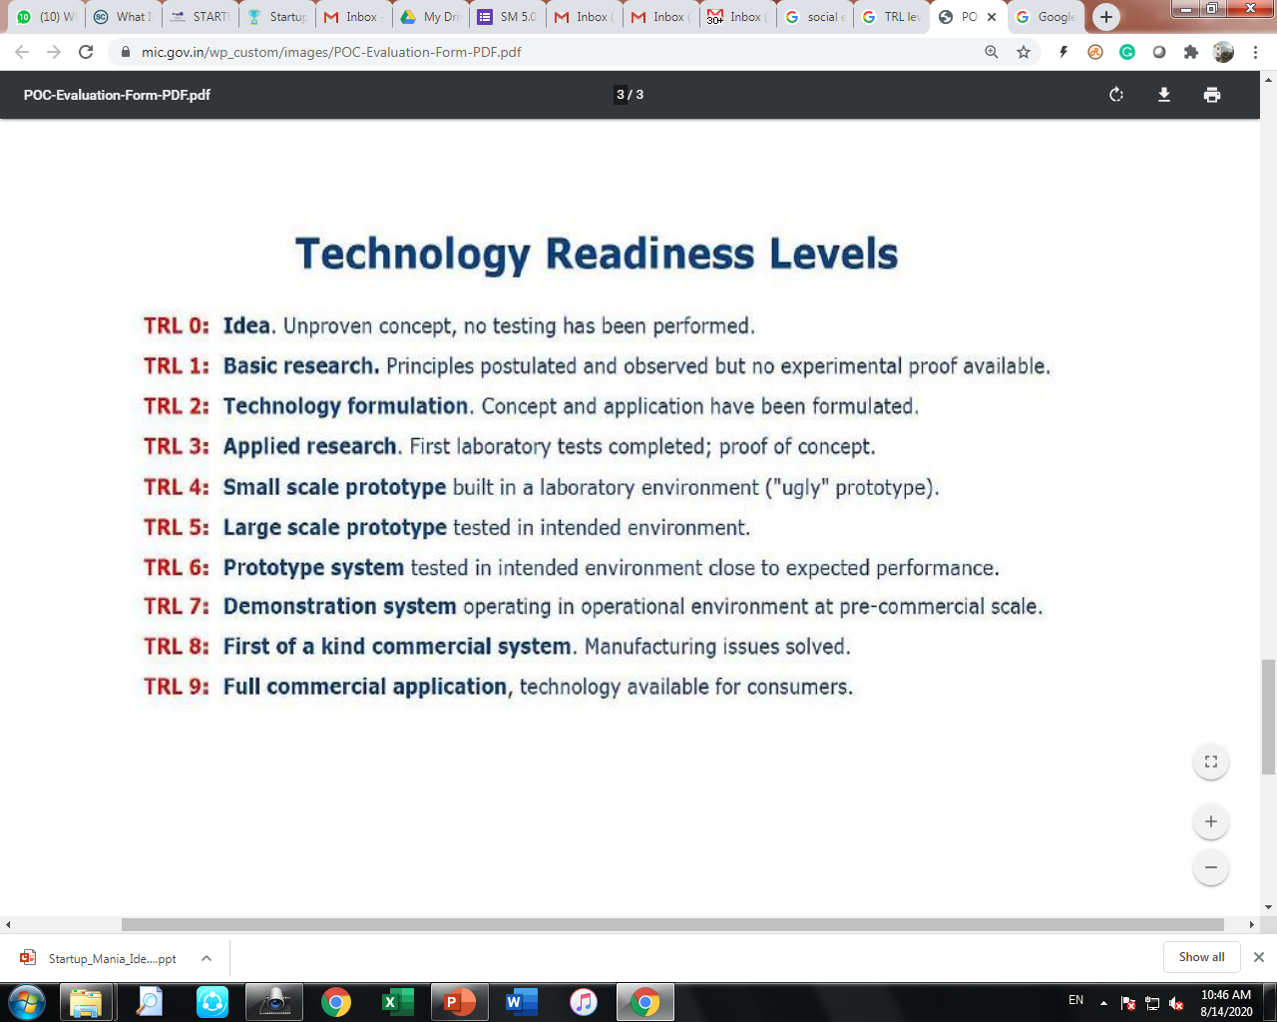

Slide 10
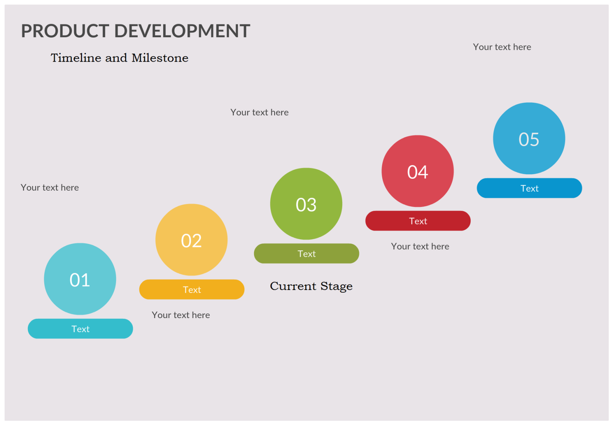

Slide 11
